Slide 1

Recipe for Success:
Data-Driven Strategies for New & Prospective Restaurant Owners in San Diego
By Tia Page

Slide 2
Overview
Introduction | Defining the problem, importance of topic
Data Collection | Resources and techniques used to obtain the data needed for analysis
Analysis of Data | Valuable findings and insights gathered through data explorations
Conclusion | Major takeaways from analysis that can help aspiring restaurant owners

Slide 3
Introduction
Problem: San Diego restaurant closures
Causes: Highly competitive area for restaurants, overly saturated market, high costs of living
Solution: High revenues earned as a result of attracting customers and establishing popularity
Project Goals: Identify the key factors of successful restaurants in San Diego, recommend optimal locations to establish business, and find ways to enhance customer experience

Slide 4
Data Collection
Data Collected: Restaurant reviews, Demographic information, geographic details, restaurant characteristics
Collection methods: Webscraping, Data Extraction
Tools: BeautifulSoup, Octospare data extractor
Websites: Google Reviews, Point2Homes.com, Bklyndesigns.com, usa.com
Final dataset: sd_reviews

Slide 5
Data Cleaning & Preparation
Removed unnecessary columns: Review likes, review urls, review response
Excluded rows with missing values
Included data that failed to extract
Incorrect/missing cuisine categories replaced using keywords in names
Merged separate datasets obtained via data extraction and web scraping

Slide 6
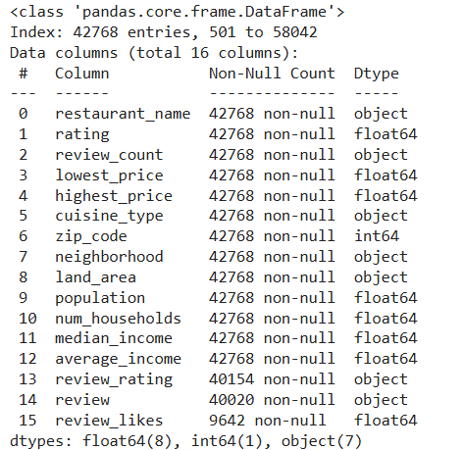
Analysis of Data: EDA

Slide 7
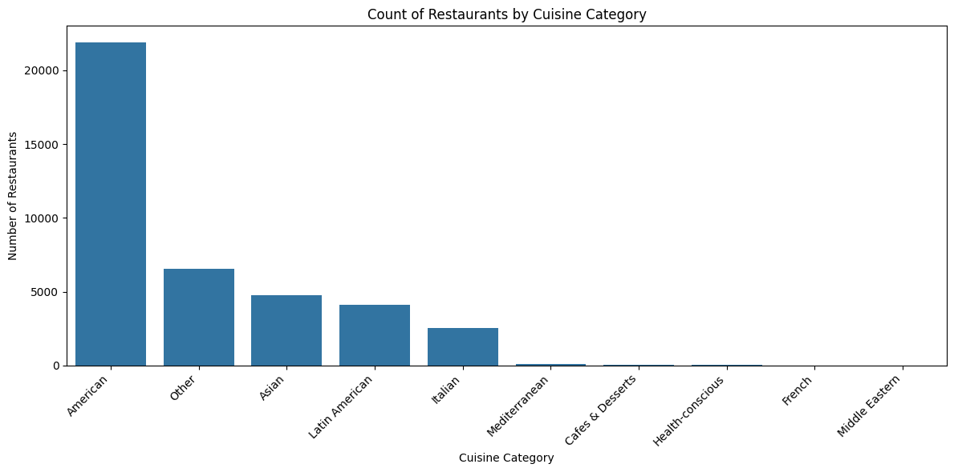
Analysis of Data: EDA

Slide 8
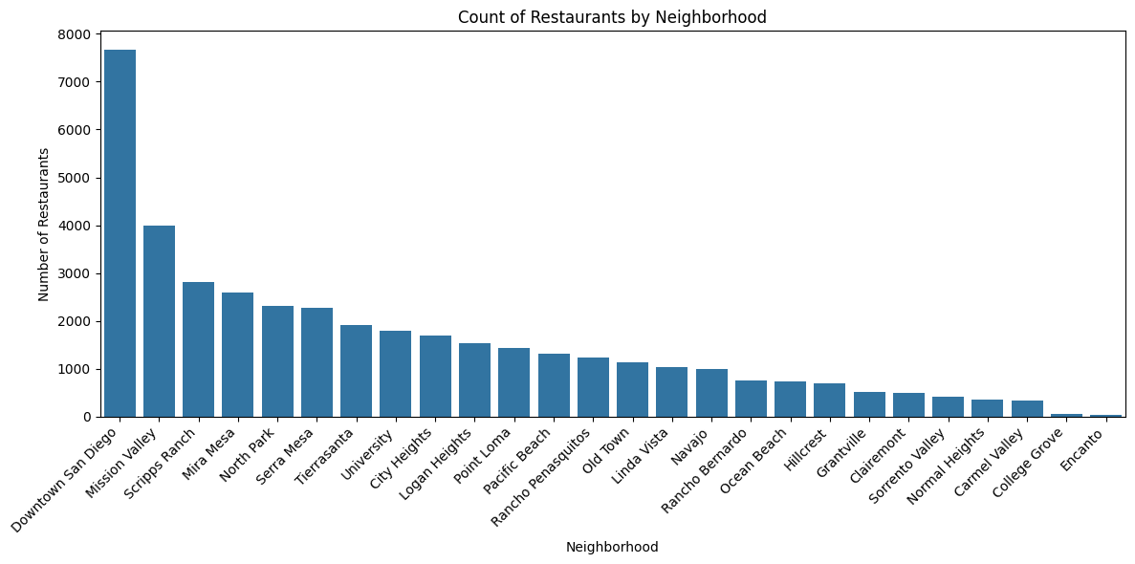
Data Collection Methods
Products or services

Slide 9
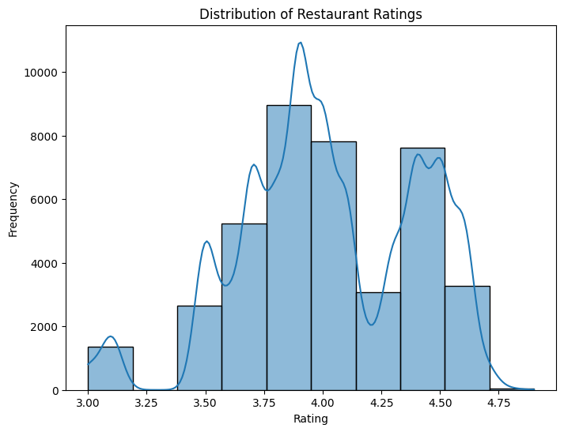
Analysis of Data: EDA

Slide 10
Addressing Goals

Slide 11
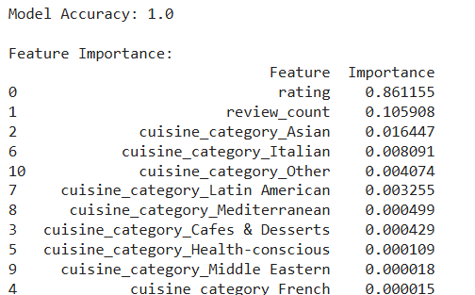
#1. Identifying key factors of successful restaurants using Random Forest Classifier Model

Slide 12
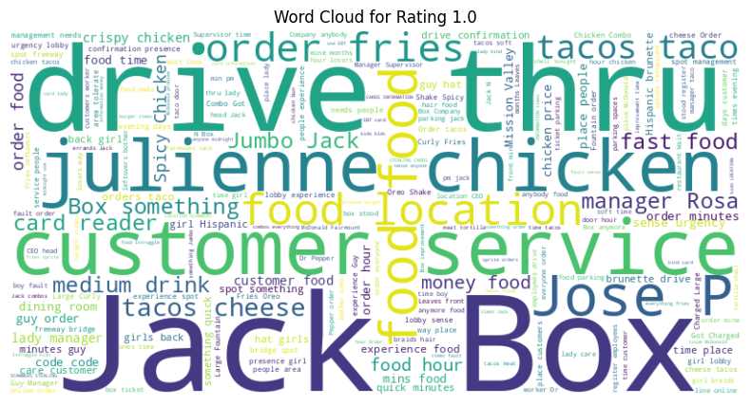
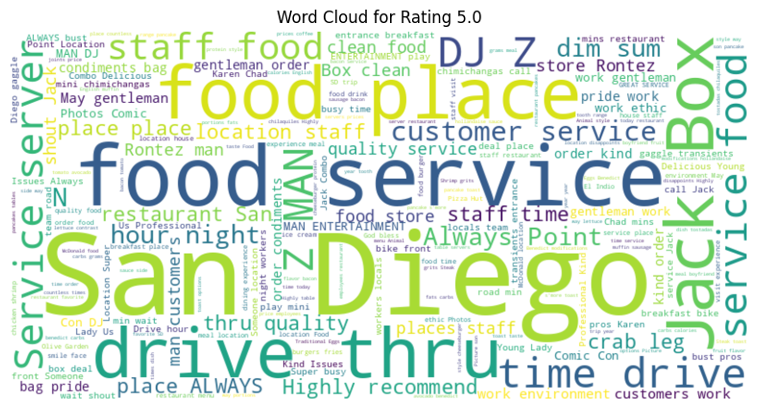
#2. Enhancing Customer Experience through TextBlob Sentiment Analysis Model

Slide 13

#3. Choosing an optimal restaurant location

Slide 14
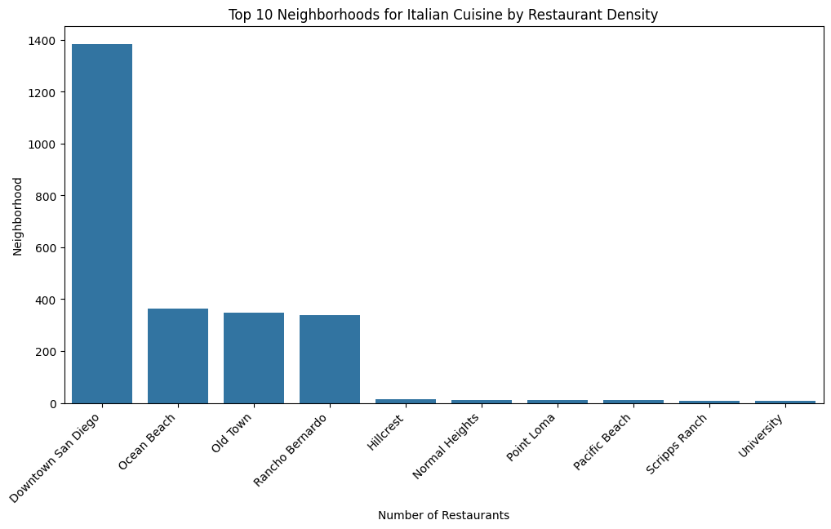
#3. Choosing an optimal restaurant location: Italian restaurant scenario

Slide 15
Conclusion: Main Takeaways
Avoid competition by establishing restaurant in area with lowest density of restaurants based on specific food categories
Enhance customer experience by first ensuring that customer service is of highest quality, then improving on food quality
Stand out from the crowd by paying attention to the least popular food categories presented in data visualization; this also shows areas with less competition

Slide 16
Online Presence
https://github.com/tpage004/MSDS692-Practicum-I---Tia-Page/tree/main

